Slide 1
Kelompok 2
Aditya Vianseto
Enggar Kristian
Mega Maharani
Muhammad Sanzabi
Rio Armiga

Slide 2
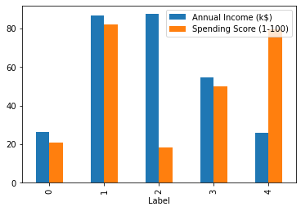
Hacktive Mall
Label | Annual Income (k$) | Spending Score (1-100)
0 | 26.304348 | 20.913043
1 | 86.538462 | 82.128205
2 | 87.432432 | 18.189189
3 | 54.822785 | 49.835443
4 | 25.727273 | 79.363636

Slide 3
Label 0
Label | Annual Income (k$) | Spending Score (1-100)
0 | 26.304348 | 20.913043
1 | 86.538462 | 82.128205
2 | 87.432432 | 18.189189
3 | 54.822785 | 49.835443
4 | 25.727273 | 79.363636
Menawarkan cashback dan promo gratis ongkir

Slide 4
Label 1
Menawarkan product high end yang bekerja sama pada product branded dan membership.
Label | Annual Income (k$) | Spending Score (1-100)
0 | 26.304348 | 20.913043
1 | 86.538462 | 82.128205
2 | 87.432432 | 18.189189
3 | 54.822785 | 49.835443
4 | 25.727273 | 79.363636

Slide 5
Label 2
Menawarkan fitur baru , menawarkan promosi pada barang yang berkualitas dengan tujuan menarik pasar
Label | Annual Income (k$) | Spending Score (1-100)
0 | 26.304348 | 20.913043
1 | 86.538462 | 82.128205
2 | 87.432432 | 18.189189
3 | 54.822785 | 49.835443
4 | 25.727273 | 79.363636

Slide 6
Label 3
Menawarkan fitur kemudahan pembayaran dan promosi terhadap jenis produk yang sama
Label | Annual Income (k$) | Spending Score (1-100)
0 | 26.304348 | 20.913043
1 | 86.538462 | 82.128205
2 | 87.432432 | 18.189189
3 | 54.822785 | 49.835443
4 | 25.727273 | 79.363636

Slide 7
Label 4
Menawarkan cashback dan fitur kredit
Label | Annual Income (k$) | Spending Score (1-100)
0 | 26.304348 | 20.913043
1 | 86.538462 | 82.128205
2 | 87.432432 | 18.189189
3 | 54.822785 | 49.835443
4 | 25.727273 | 79.363636

